Slide 1
GA Safety Performance
Final FY17
GA Summit 2017

Slide 2
GA Safety Performance Metrics
N-registered aircraft only
Overall GA Fatal Accidents per 100,000 hrs
  Everything not 121, or Scheduled Part 135 (commuter)
Alaska Fatal and Serious Injury Accidents per 100,000 hours (Internal)
  Everything not 121, but includes all Part 135 (both scheduled and non-scheduled)
Experimental Aircraft Fatal Accidents

Slide 3
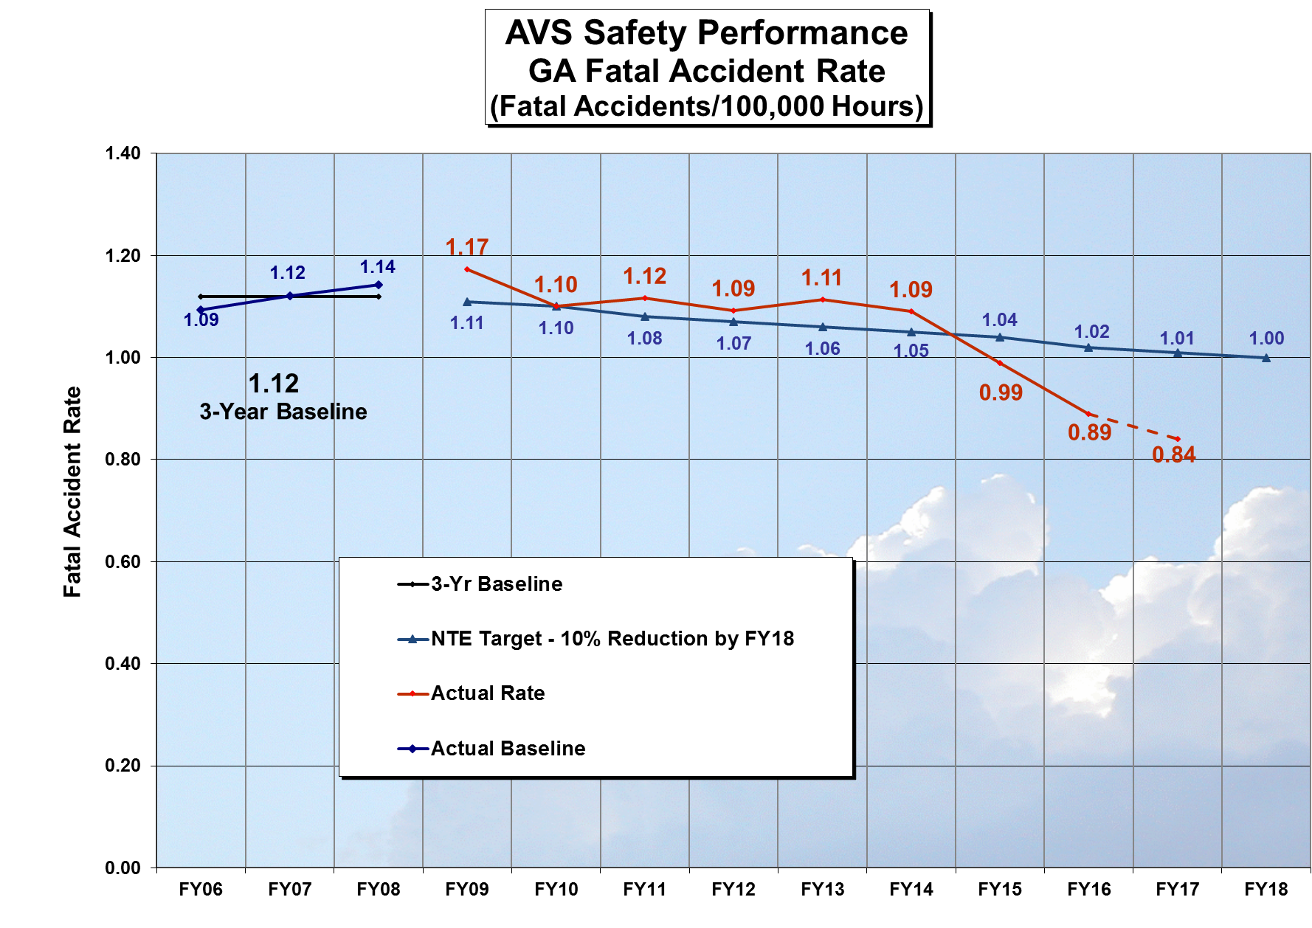

Slide 5
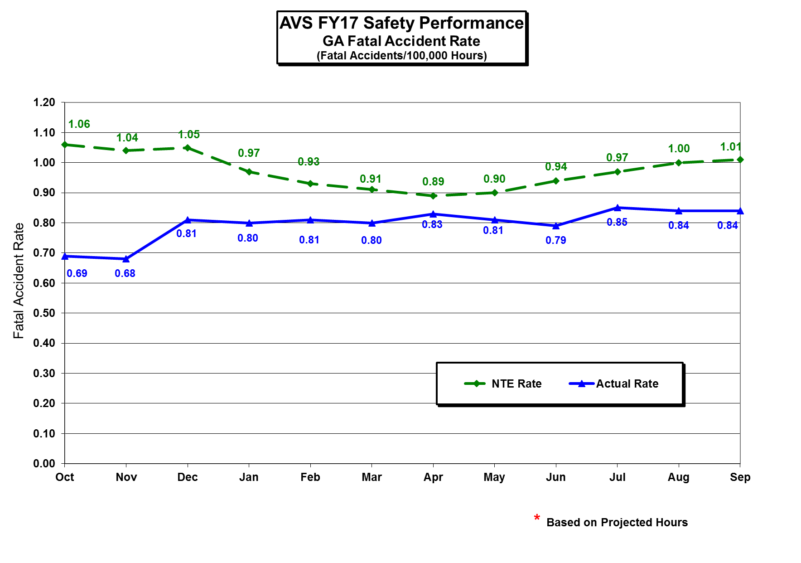

Slide 7
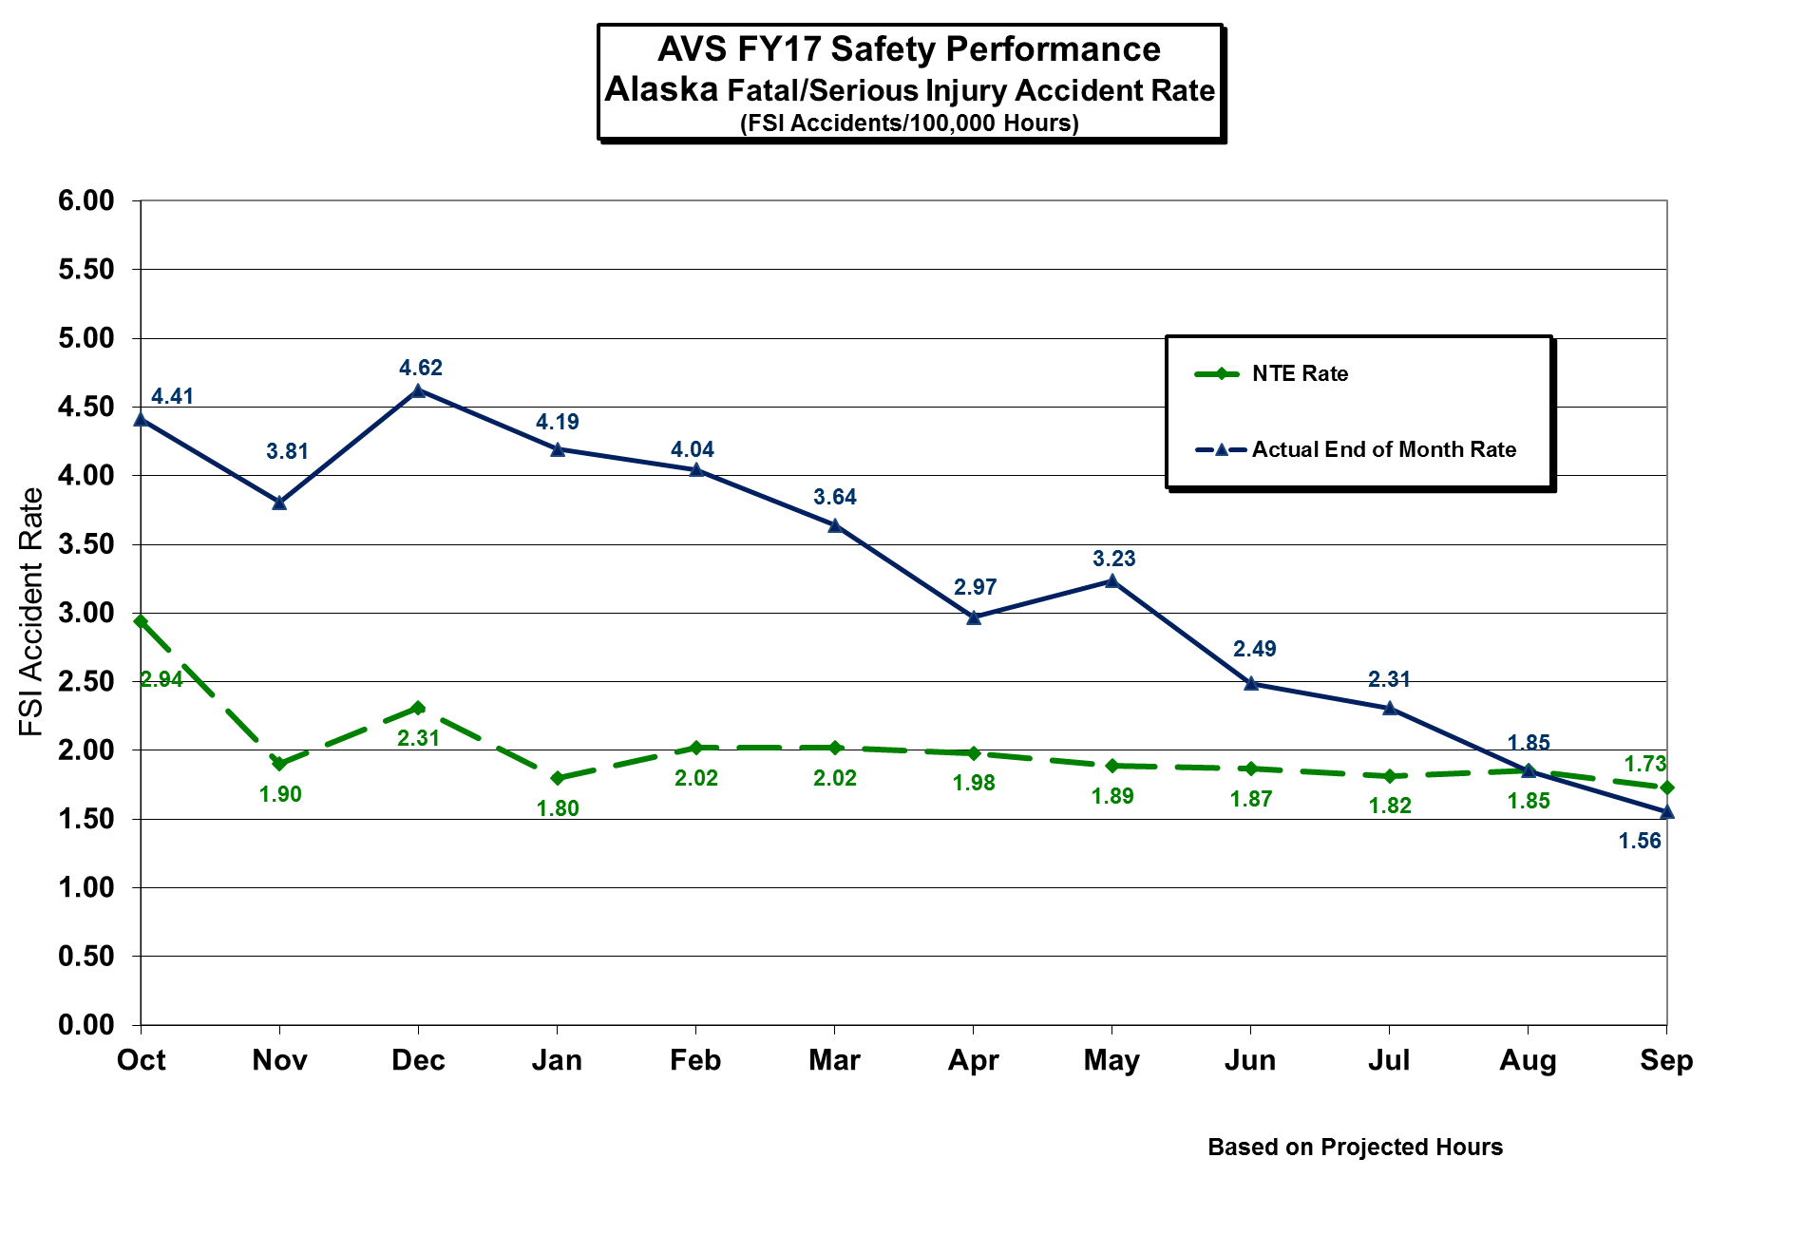

Slide 8
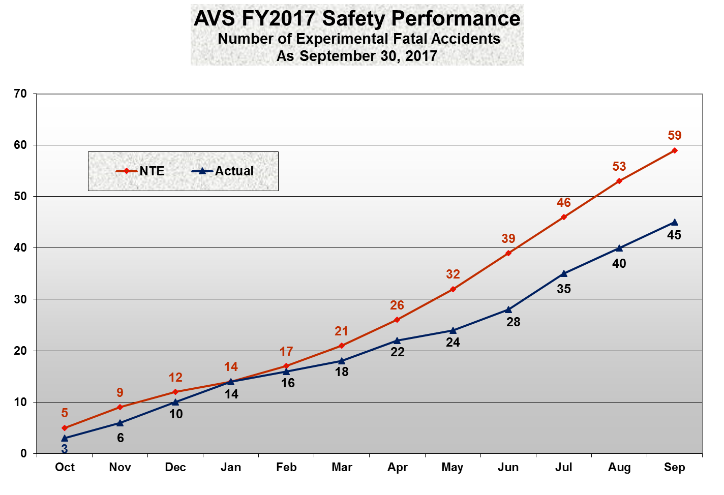

Slide 10
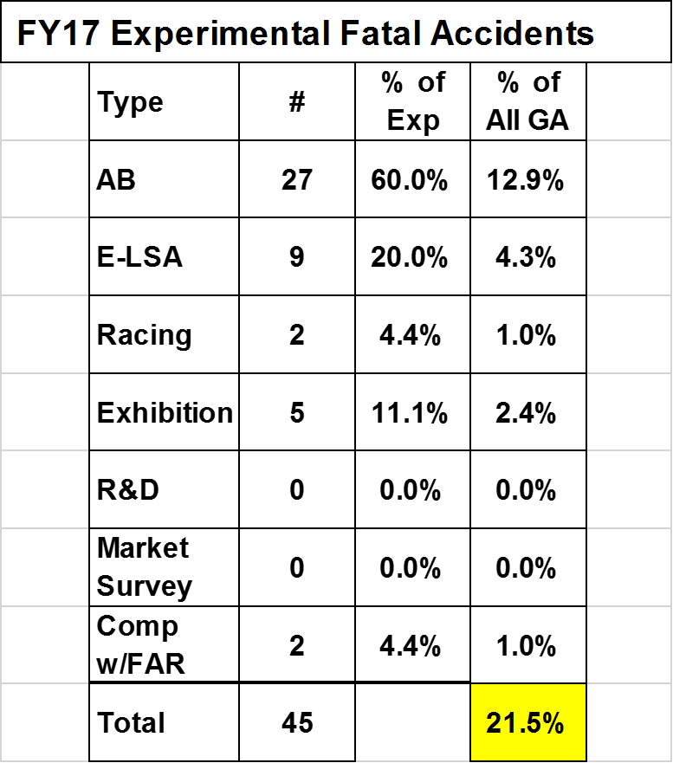
Link to
Definitions

Slide 11
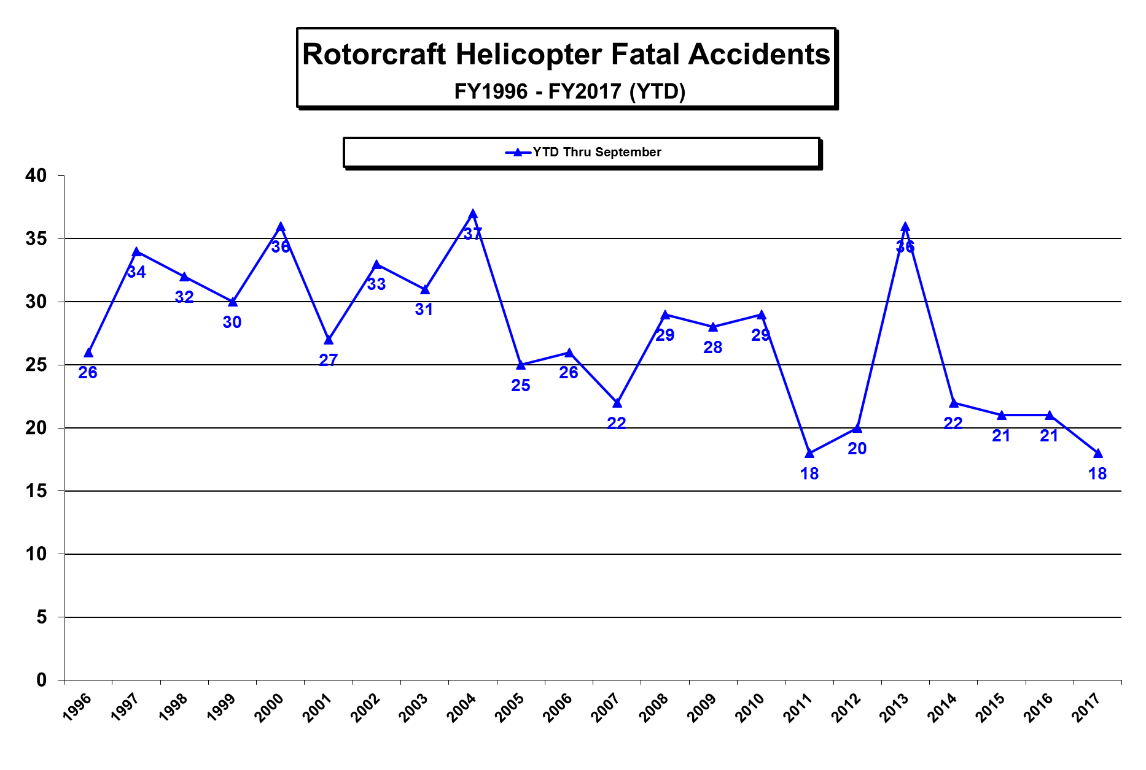

Slide 12
Comments or Question?

Slide 13
Backup Slides

Slide 14
Experimental Aircraft Definitions
Amateur-built, kit-built
Experimental-light-sport aircraft
Air racing: to operate an aircraft in air races, practice for air races, and to fly to and from racing events.
Exhibition: to exhibit an aircraft’s flight capabilities, performance, or unusual characteristics for air shows, motion pictures, television, and similar productions, and for the maintenance of exhibition flight proficiency.
Research and development: to conduct aircraft operations as a matter of research or to determine if an idea warrants further development. Typical uses for this certificate include new equipment installations, operating techniques, or new uses for aircraft.
Market surveys: to conduct market surveys, sales demonstrations, and customer crew training for U.S. manufacturers of aircraft or engines.
Showing compliance with regulations: to show compliance to the airworthiness regulations when an applicant has revised the type certificate design data or has applied for a supplemental type certificate or field approval.
Return

